Slide 1

THE LAYERED TETRAD
CHAPTER 03
‹#›

Slide 2
Topics
The Layered Tetrad
The Inscribed Layer
The Dynamic Layer
The Cultural Layer
The Responsibility of the Designer
‹#›

Slide 3
The Layered Tetrad
The last chapter presented several frameworks
This Layered Tetrad is the framework of this class
Expands upon those that came before it
Considers the cultural significance and impact of games
Does not define what a game is
Instead helps you understand and analyze
The elements that are needed to make a game
The dynamic behavior of those elements during play
Both the impact of the game on culture and the affect of culture on the game
We use the term game, but this is applicable to any form of interactive media or experience
‹#›

Slide 4
The Layered Tetrad
Presented in a tetrad (based on Schell's)
Mechanics: The systems that define how the game will react to play. The elements that separate games from other media
Aesthetics: The looks, sounds, smells, tastes, and tactile sensations of the game. Game art, sound, and more.
Technology: The underlying tech that makes the game work.
Narrative: The story, premise, characters, etc. of the game. Renamed from Schell's to show its breadth.
Presented in three layers
Inscribed: The game as created and encoded by the developers
Dynamic: The game's behavior during play
Cultural: The game's relationship to society
‹#›

Slide 5
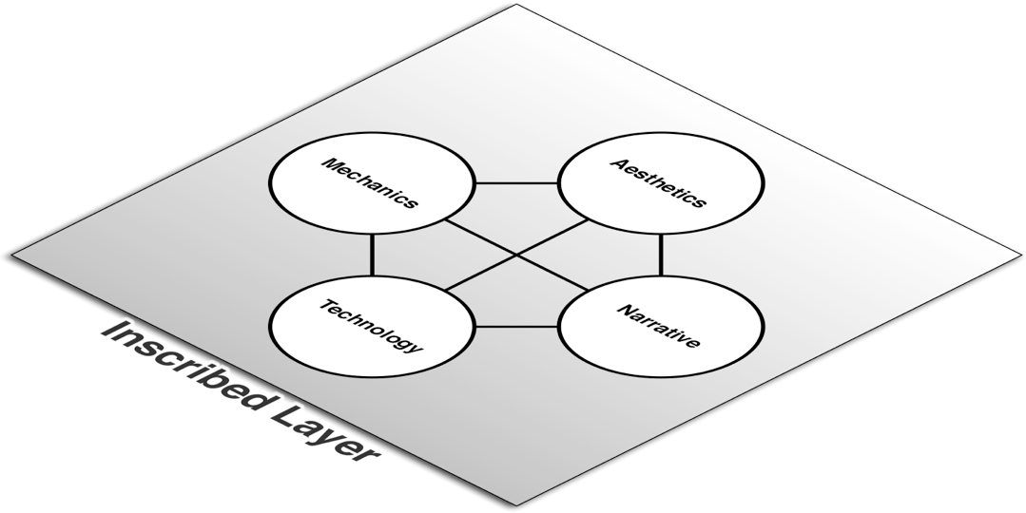
The Inscribed Layer
Game as created and encoded by developers
Similar to Schell's Elemental Tetrad
Limited to elements that exist when the game is not being played
‹#›

Slide 6
The Inscribed Layer
Mechanics
Systems that define how the player and game will interact
Includes: Player interaction pattern, Objective, Rules, Resources, Boundaries
Aesthetics
How the game looks, sounds, smells, tastes, and feels
Technology
Paper and digital technology that enable gameplay
Narrative
Authored premise, characters, and plot
‹#›

Slide 7

The Dynamic Layer
The game as it is being played
Players move the game into the dynamic layer
Players
‹#›

Slide 8
The Dynamic Layer
Mechanics
Players' interactions with inscribed mechanics
Includes: Procedures, Strategies, Emergent game behavior, Outcome
Aesthetics
Aesthetics that are generated during play
Play environment
Technology
Execution of inscribed technology and code
Narrative
Narrative created as a part or result of gameplay
‹#›

Slide 9

The Cultural Layer
The game beyond play
Intersection of game community and society
Society
Communities
Players
‹#›

Slide 10
The Cultural Layer
Mechanics
Game mods created by players that alter the Inscribed Layer
Impact of emergent play on society
Aesthetics
Fan art, remixes, cosplay
Does not include authorized transmedia
Technology
Game tech used for non-game purposes
Effect of external cheating technology on game
Narrative
Fan-made narratives
‹#›

Slide 11
The Cultural Layer
The divisions between the four elements are less crisp in the Cultural Layer
The four elements intermingle in several of the examples from the last slide
The Cultural Layer is also the only layer of a game that non-players will ever see
People who don't play a game experience it through the stories told by those who have
The collision of the community of players and larger society
What messages are our games sending into society?
‹#›

Slide 12
The Responsibility of the Designer
All designers understand their responsibility for the Inscribed Layer
Most understand their responsibility for the Dynamic Layer
Example of Team Fortress 2 hat behavior
Responsibility at the Cultural Layer?
The common perception of games
Puerile, Vulgar, Violent, Misogynistic
Does it have to be this way?
Games can be…
Prosocial
Educational
Meaningful
What else?
‹#›

Slide 13
The Responsibility of the Designer
What can interactive media become?
How can you as designers push the term game beyond what it means now?
How can you make your families and friends proud that you're entering this industry?
How can you respect your players and treat them well?
I believe that it is our responsibility as designers to
Promote pro-social, thoughtful behavior through our games
Respect our players and the time that they dedicate to experiencing what we create.
‹#›

Slide 14
Chapter 3 – Summary
The three layers represent a transition of agency from the developers to the players of a game
The Inscribed Layer is entirely controlled by developers
The Dynamic Layer is controlled by both developers and players
The Cultural Layer is influenced by developers but ultimately controlled by players and society at large
Next Chapter: The next three chapters will each tackle one of the three layers
Chapter 4: The Inscribed Layer
Chapter 5: The Dynamic Layer
Chapter 6: The Cultural Layer
‹#›

